Slide 1
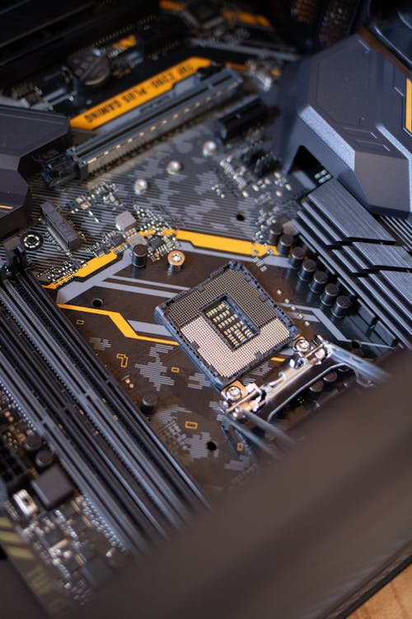

A small intro to compilers by parsing maths

Slide 2
Who am I?

Slide 3
Layout of the talk

Slide 4
Lexing

Slide 5
Parsing

Slide 6
Compiling

Slide 7
Running / Virtual Machine

Slide 8
Missing features
Brackets
Any errors

Slide 9
Missing Steps
Lowering (high level constructs to low level ones)
Optimizations (Constant folding)

